Slide 1
Building Unconventional SQL Server Tools in PowerShell

Slide 2

Get-Help –Name ‘about_Presenter’
Mike F Robbins
Microsoft MVP on Windows PowerShell
SAPIEN Technologies MVP
Leader & Co-Founder of Mississippi PowerShell User Group
Co-Author of Windows PowerShell TFM 4th Edition
Author of Chapter 6 in the PowerShell Deep Dives book
Winner of the Advanced Category in the 2013 Scripting Games
Learn more about me @ mikefrobbins.com

Slide 3
Write-Output ‘Questions for Audience’
IT Pro’s
Developers
Database Administrators
Microsoft SQL Server
PowerShell
Transact-SQL (T-SQL)
.NET Framework
Source Control
Unit Testing

Slide 4
Set-Content ‘Information to Cover’
SQL PowerShell Module and Snap-in
SQL PowerShell Provider
SMO (SQL Management Objects)
.NET Framework
TSQL versus Cmdlets
Functions
Modules
Toolmaking
Automation
Using PowerShell to write dynamic TSQL code

Slide 5
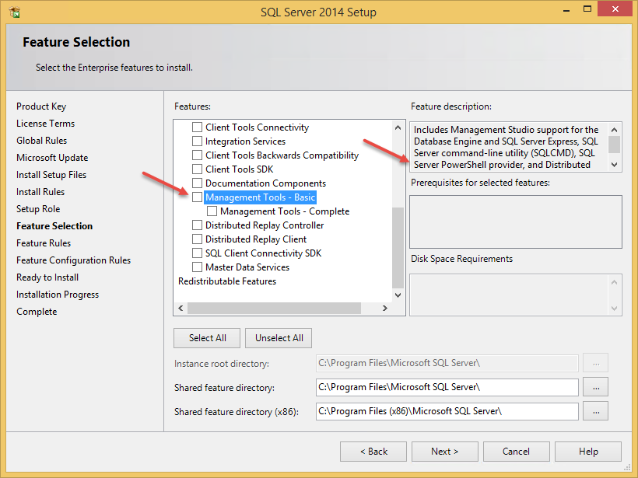
Install the SQL PowerShell Module (Old)

Slide 6
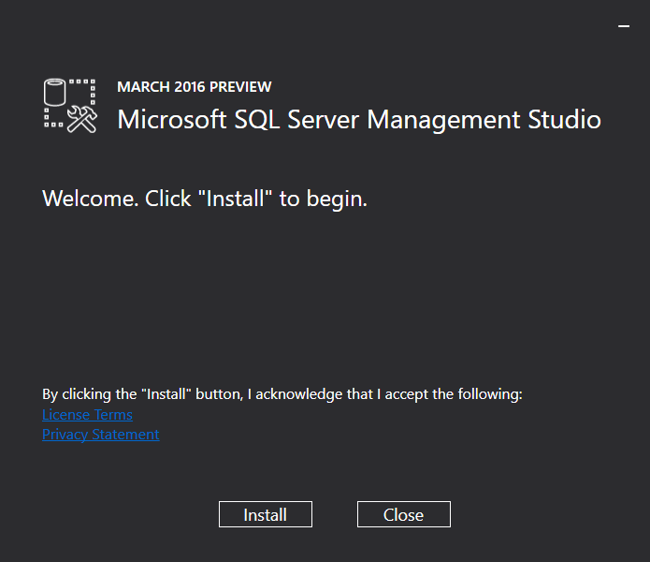
Install the SQL PowerShell Module (New)

Slide 7

Start-Process ‘Demo’
Demo Code: github.com/mikefrobbins/Presentations

Slide 8
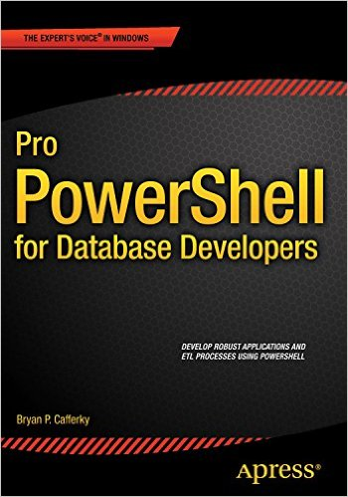

Select-Object –Property ‘Resources’
PowerShell.org
PowerShell Virtual Chapter of SQL PASS
SQL Saturday Technology Events
Microsoft Virtual Academy
PowerShell Magazine
User Groups
Twitter
GitHub
Blogs
PowerShell Best Practices and Style Guide

Slide 9

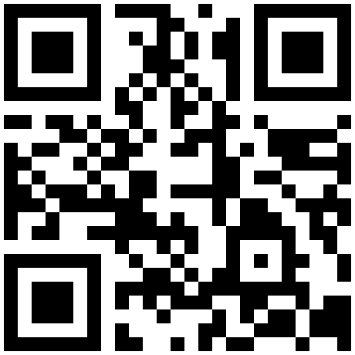

Get-Contact –Identity ‘Presenter’
Blog: mikefrobbins.com (or MrPowerShell.com)
Twitter: @mikefrobbins
LinkedIn: www.linkedin.com/in/mikefrobbins
E-Mail: See mikefrobbins.com/about/
User Group: mspsug.com (or MsPowerShell.com)

